Slide 1

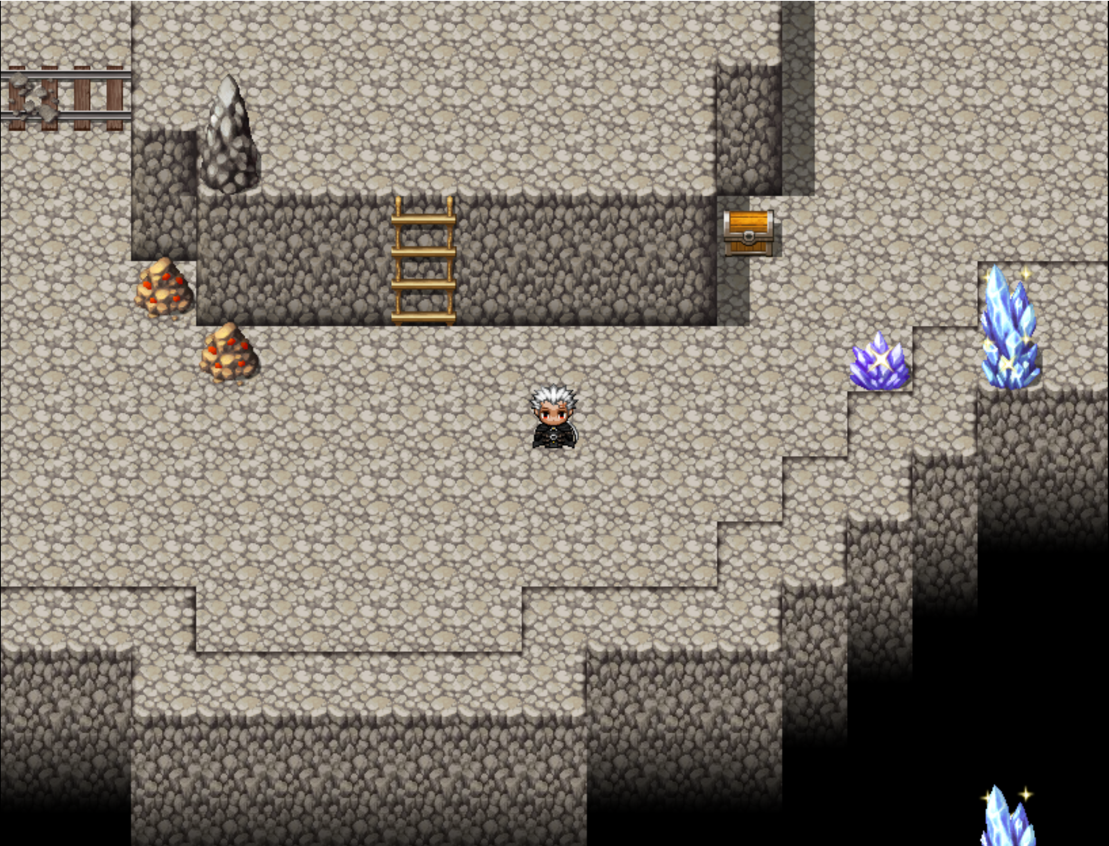
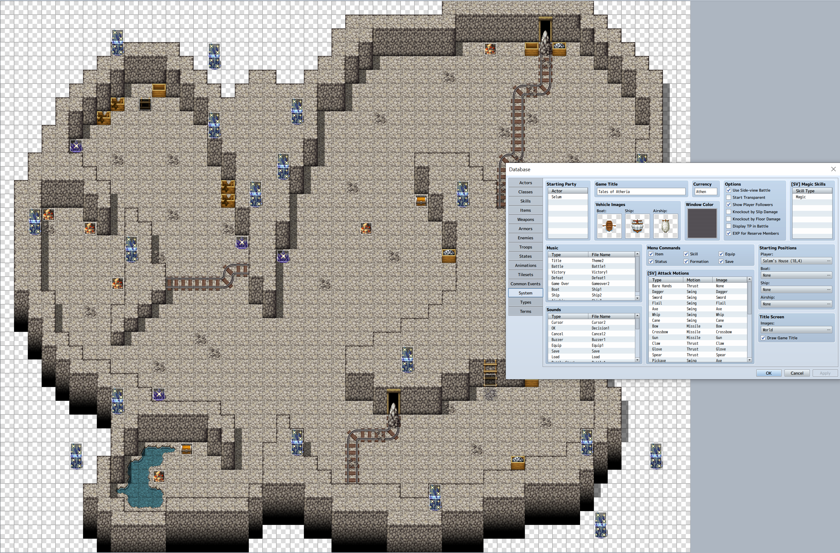
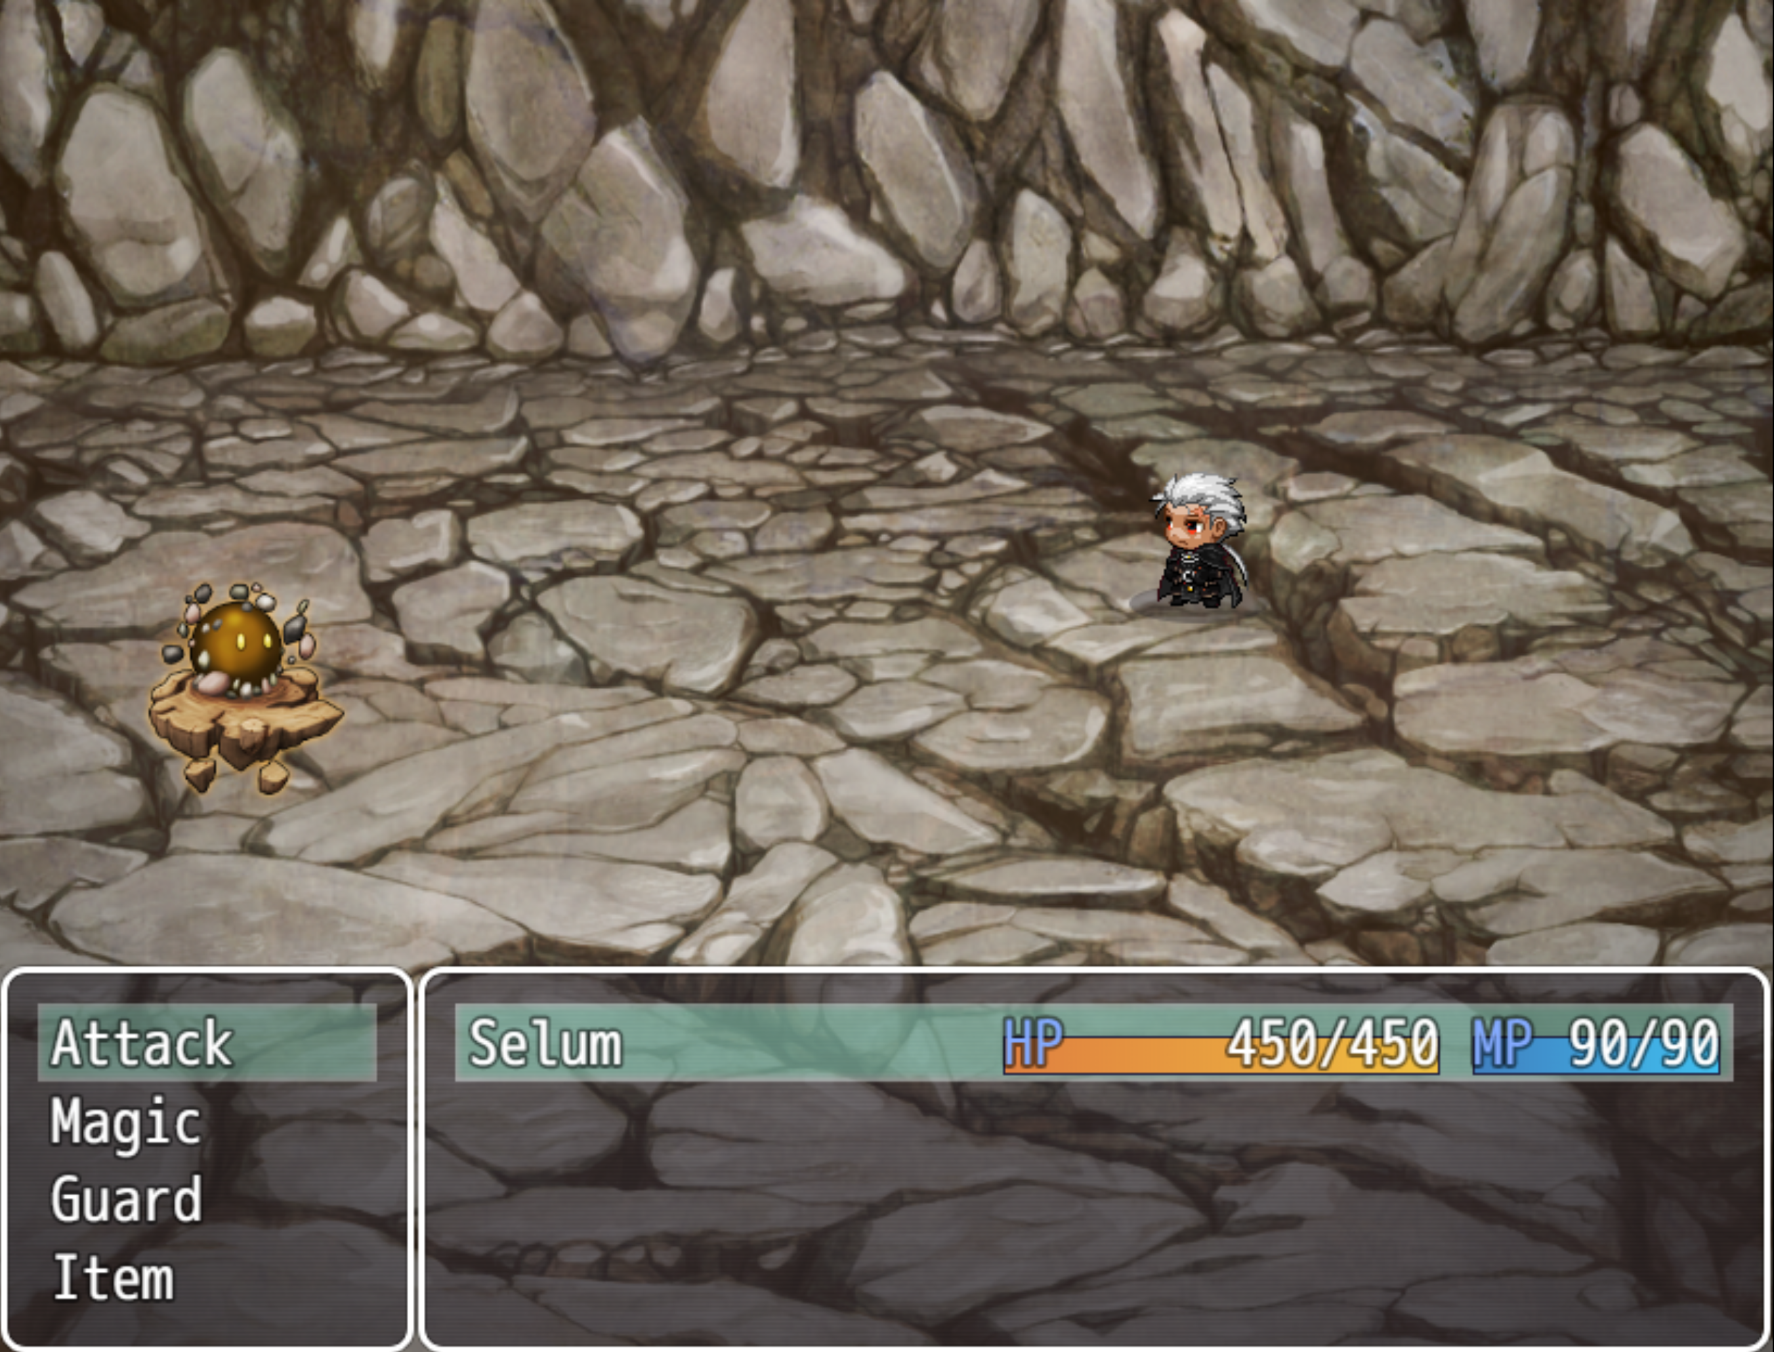


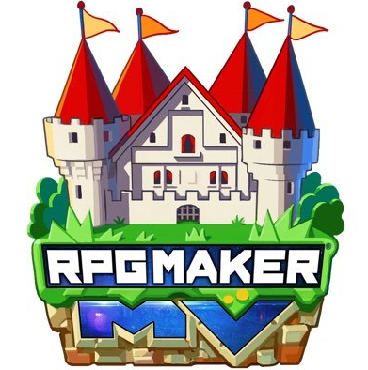

Tales of Atheria
Karl Miller, BSHCSD4
Overview
It's a 4th year NCI project, A top-down 2D Rouge lite that was developed with RPGmaker MV with some art assets created with Aesprite.
Motivation
I've always had a strong fascination with Videogames, With that I took the opportunity to create a videogame so I could learn more about the professional process behind it for the future.
How it Works
Once you step down into the mines you need to collect as many ores and items as you can but the monsters in the caves won't make it easy for you to keep your loot!
LinkedIn
Technologies

